Slide 1

The Travel Experts Inc.
Software Package Project Proposal
MMBJ Developers
Presented by: John, Megha, Brian and Mahmood
November 21, 2014

Slide 2



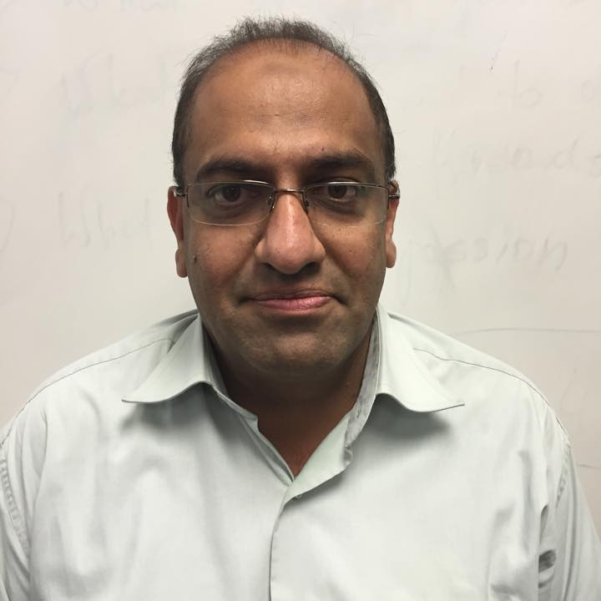
The MMBJ Team
John Nguyen
Megha Patel
Brian Peng
Mahmood Qureshi
Team Lead
Software Developer
Software Developer
Software Developer
MMBJ Development Inc. has over 35 years of software development experience and have developed software solutions for companies in industries such as finance, education, and tourism industries. We specialize on complete software and hardware solutions to ensure all of your requirements are met.

Slide 3
Goals
To build a user-friendly system and interface
Easy to store information of our customers and agents
Compatible with hardware and software
Quality of expertise
Ability to collect feedback

Slide 4
Objectives
Reducing customer complaints by 80%
Processing several hundred requests from clients at the same time
Improving the efficiency of the package booking function

Slide 5
Assumptions - Contingencies
1
Users Technical Skills
1
User Training / Orientation of System
2
Scalability
2
Hosting Options
3
System Failure
3
OS, Hardware, Power etc.
4
Conflicts / Variations
4
Keep Hard Copies / Maintenance Period

Slide 6
Assumption: Users Technical Skills
Contingency Plan: User Training / Orientation of System
Setting training goals
Assessment of end user needs
Software training
Training delivery methods
Group demonstration of system using projector
One to one training / feedback
Training documentation
Hard copies of training material for new employees

Slide 7
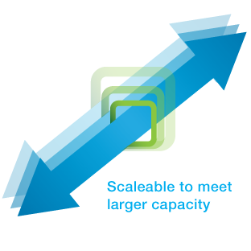
Assumption: Scalability
Scalability is the ability of system to handle growth in a capable manner
Contingency Plan:
Hosting options
Self Hosting
Third Party
Hosting with us

Slide 8
Assumptions
Contingencies
System failures
Hardware failure
Software failure
Power failure
Implementing mirroring on hard drive
Using Antivirus software
Daily and weekly backups
Keeping backup copy offsite
Implementing UPS

Slide 9
Assumption: Conflicts / Variations
Contingency Plan:
Keep hard copies for evaluation
Weekly / monthly reviews in meeting
3 month maintenance period
Change in the code
Change in the layout / structure
Change in the reporting system

Slide 10
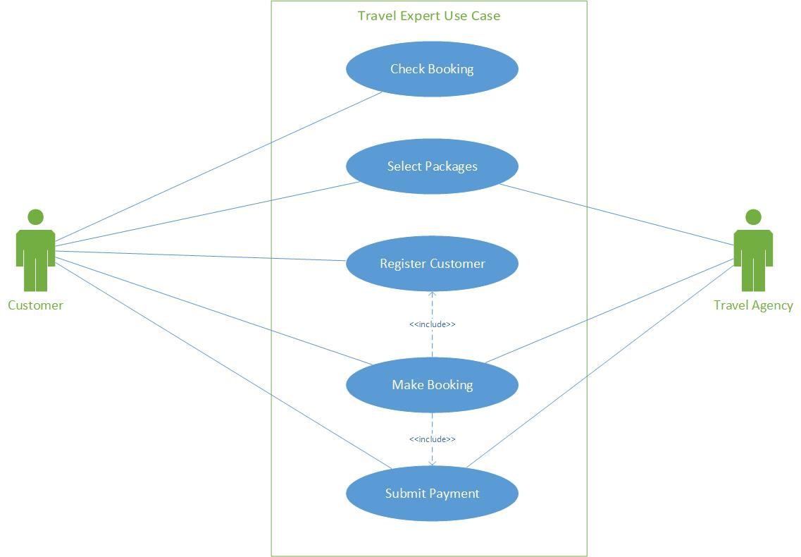
Use Case Diagram

Slide 11

Scope Definition
Database Design
Application Development
Web-Based Menu
Web-Based Reports & Analytics
Placing Orders Online

Slide 12



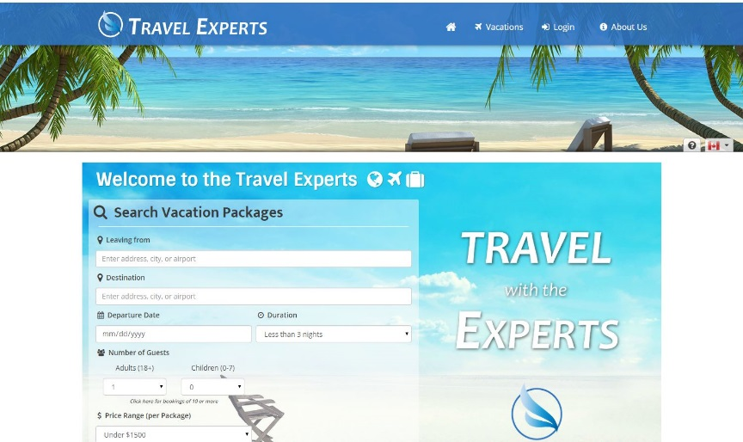
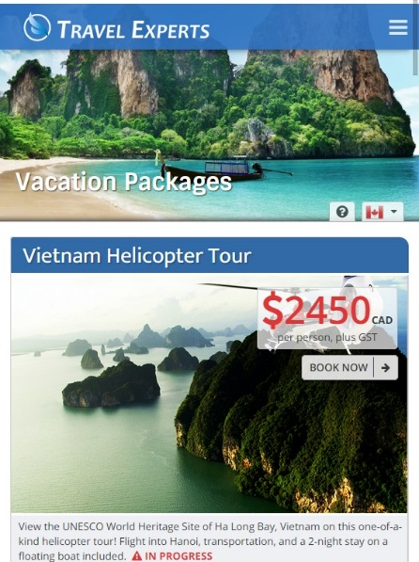

Live Demonstration

Slide 13
Future Implementation
Agent Login Portal
Website translation to multiple languages
Multiple currency capabilities
Comprehensive travel packages (flights, hotels, vehicles, etc.)
Live customer support integration
Completely virtual travel agency

Slide 14

Questions or Comments?

